Slide 1
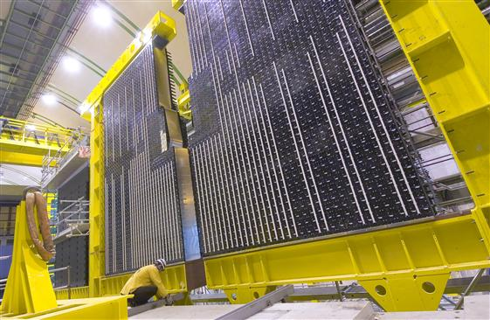

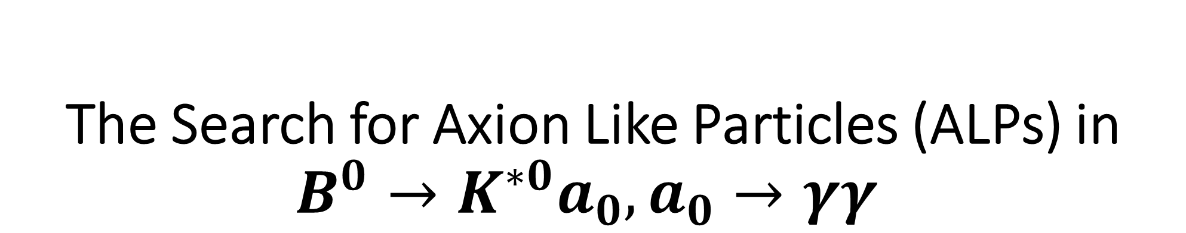
The Search for Axion Like Particles (ALPs) in $B^{0}→K^{∗0}a_{0}, a_{0}→γγ$
Subrahmanya “Sai” Pemmaraju, Ulrik Egede
Monash University, Melbourne, Australia

Slide 2
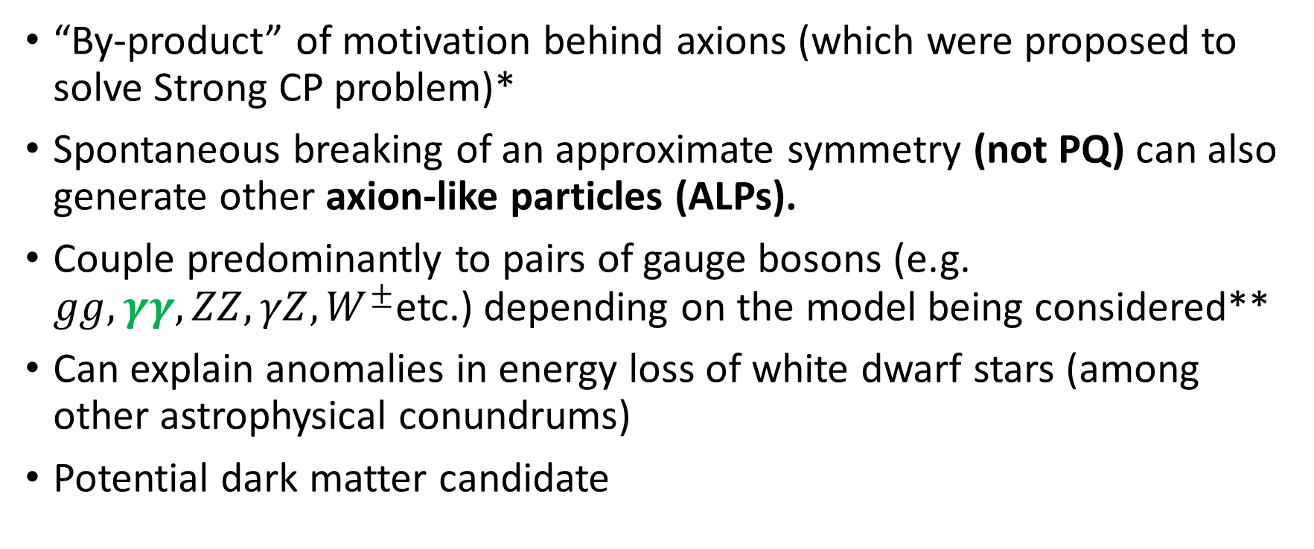
Background and Motivation
“By-product” of motivation behind axions (which were proposed to solve Strong CP problem)*
Spontaneous breaking of an approximate symmetry (not PQ) can also generate other axion-like particles (ALPs).
Couple predominantly to pairs of gauge bosons (e.g. $gg, γγ, ZZ, γZ, W^{±}$etc.) depending on the model being considered**
Can explain anomalies in energy loss of white dwarf stars (among other astrophysical conundrums)
Potential dark matter candidate
* R D Peccei (2006) Axions and the Strong CP Problem: https://arxiv.org/abs/hep-ph/0607268
** Ringwald (2014) Axions and Axion-Like Particles: https://arxiv.org/pdf/1407.0546.pdf
Notes:
SB of approximate symmetry (NOT PQ symmetry) can generate ALPs (they are similar to axions)
Masses and couplings to photons are independent for ALPs, whereas they vary inversely in the case of axions
Couple predominantly to pairs of gauge bosons, depending on model being considered
Hypothetical, feebly interacting pcle => Candidate for DM
Helps solve various astrophysical puzzles (e.g. anomalies in energy loss of white dwarf stars)**

Slide 3
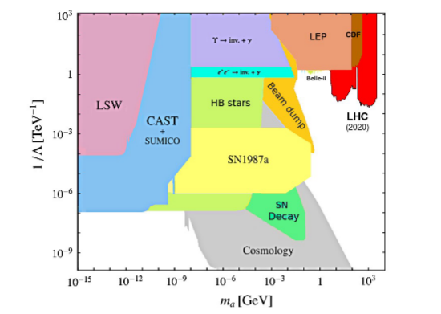
Experimental Searches for Axions and ALPs
Spin-selection rules => light pseudoscalars naturally couple to photons
Search strategies generally exploit the (inverse) Primakoff effect
Notable search strategies (excluding collider searches):
LSW (Light Shining Through Walls) Experiments
Any Light Particles Search (ALPS I)
ALPS II
Helioscope Searches
International Axion Observatory (IAXO)
CERN Axion Space Telescope (CAST)
Haloscope Searches
Axion Dark Matter Experiment (ADMX)
PIXIE
PRISM CMB
Source: A. Ringwald. Axions and axion-like particles, 2014.
Notes:
Spin selection rules => Axions and ALPs naturally couple to photons
Search strategies generally exploit the (inverse) Primakoff effect, wherein axions are converted into pairs of photons and vice versa
Notable search strategies include:
LSW: Send laser photons along strong B field and allow for conversion to ALPs on one side of a wall. ALPs might reconvert into photons on the other side of the wall
Helioscope: Detecting solar ALPs which convert into photons in presence of strong B-field
Haloscope: Direct search for galactic halo DM axions and ALPs in the lab
Plot: constraints imposed on the mass and coupling strength to photons of ALPs by the different search strategies.

Slide 4
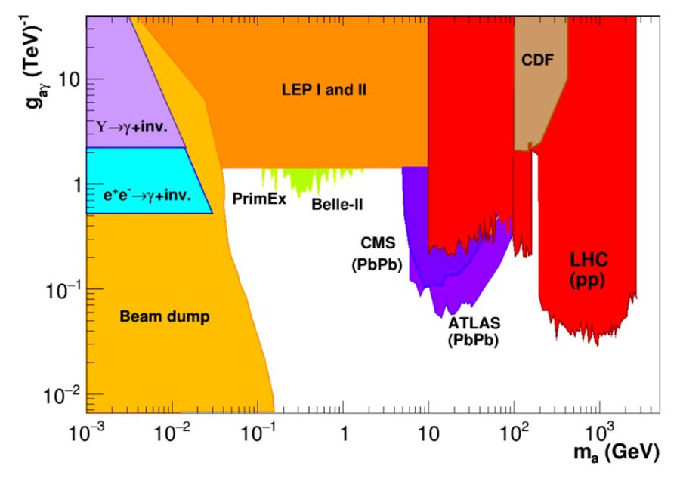
Summary of Mass and Coupling Constraints

Slide 5
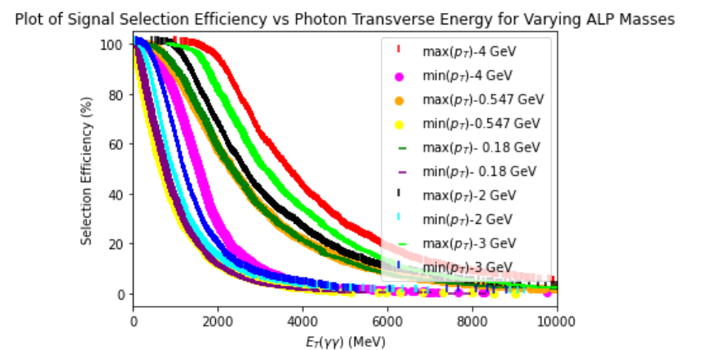
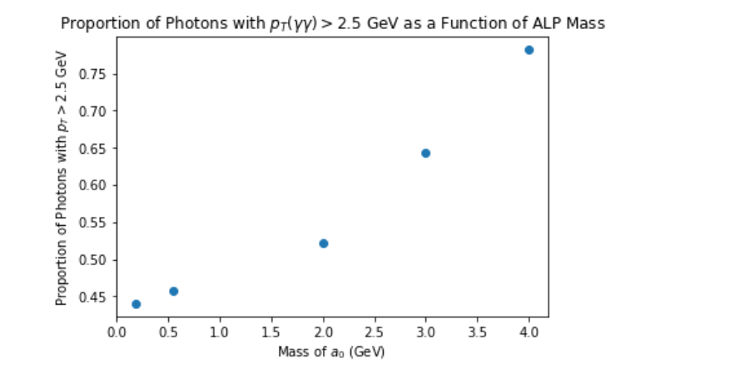

Electromagnetic Trigger Study
Preliminary studies to look at how events will survive EM trigger in Run 2 data
Seek to determine how $ε_{sel}^{γγ}$ varies as a function of ALP mass
Will determine if efficiency using $B→K^{∗}γ$ stripping is high enough to make an analysis for Run 1 and 2. Otherwise aim at Run 3.
Work in progress: Requested simulated data for $m_{a_{0}}$= 0.180, 1, and 3 GeV.

